Slide 1
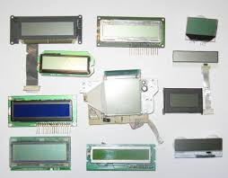
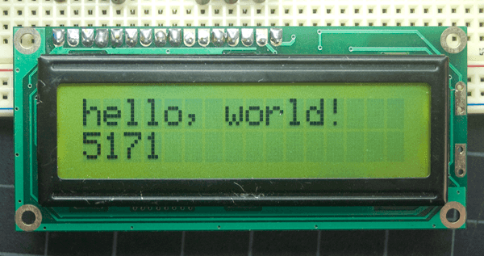
LCD Displays
Notes:
https://howtomechatronics.com/tutorials/arduino/lcd-tutorial/

Slide 2
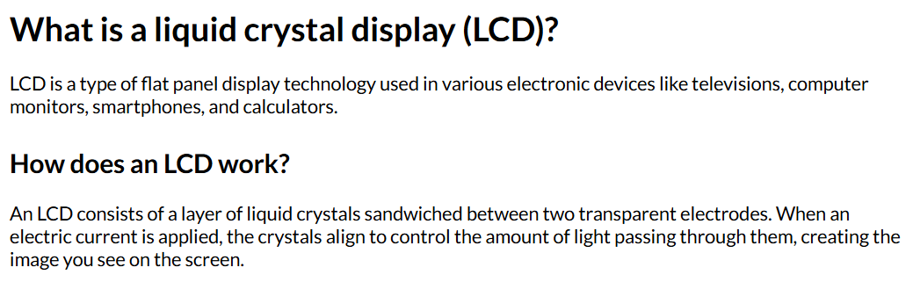
Notes:
https://www.lenovo.com/gb/en/glossary/what-is-lcd/

Slide 3
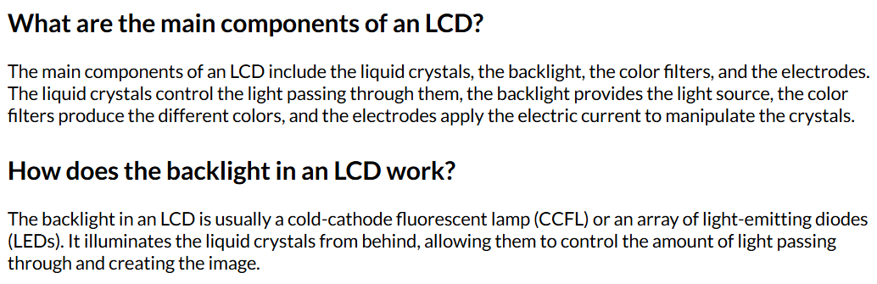

Slide 4
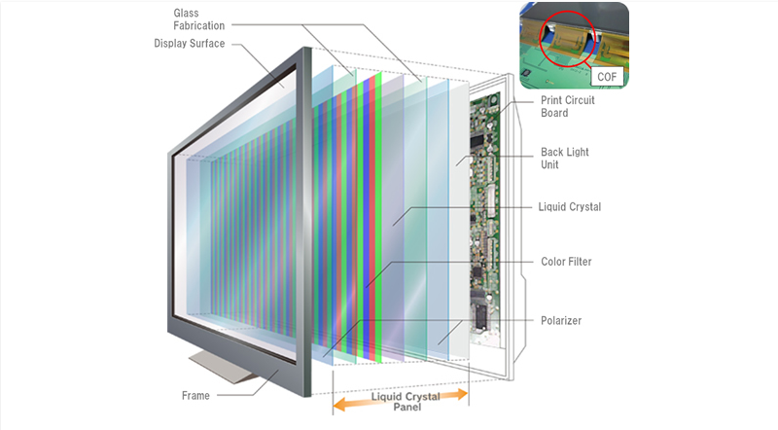

Slide 5
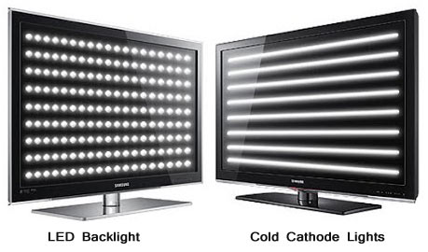
LED vs LCD displays

Slide 6
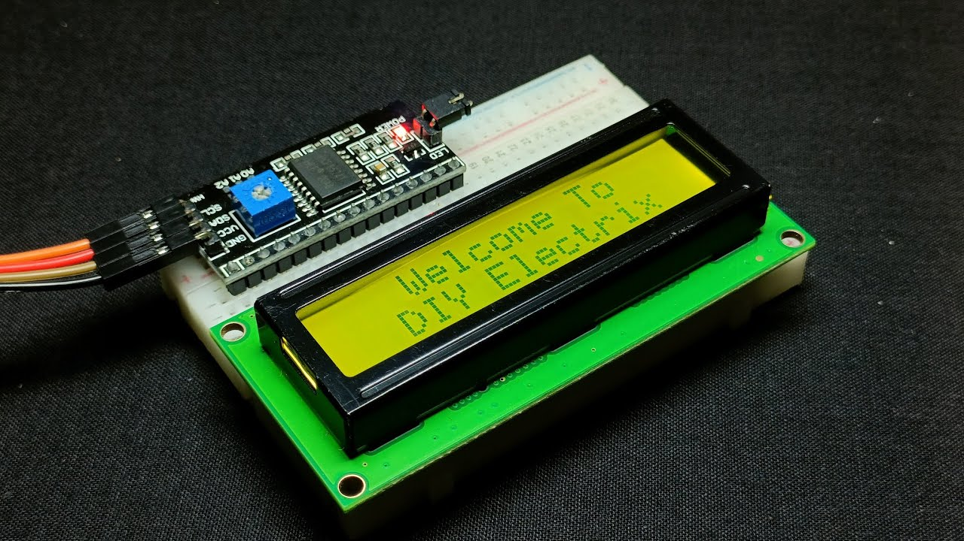
Advantages of LCD (in electronics applications)
Low power consumption
Thin and lightweight
No geometric distortion
Sharp images with good color reproduction

Slide 7
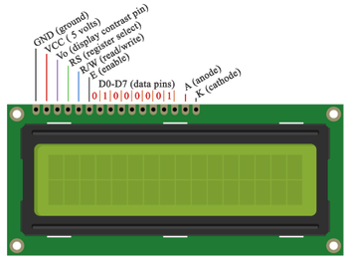
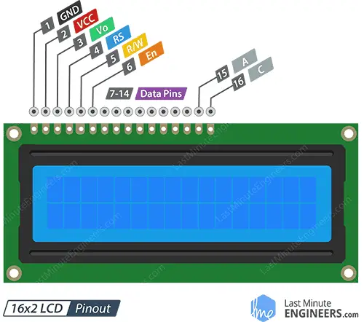
LCD Screen Pinout

Slide 8
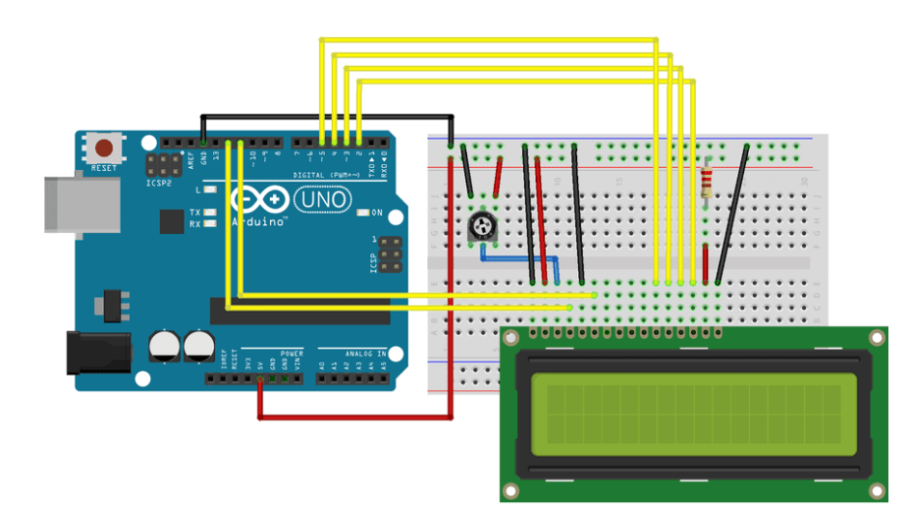
Liquid Crystal Displays (LCD) with Arduino
Notes:
https://docs.arduino.cc/learn/electronics/lcd-displays/

Slide 9
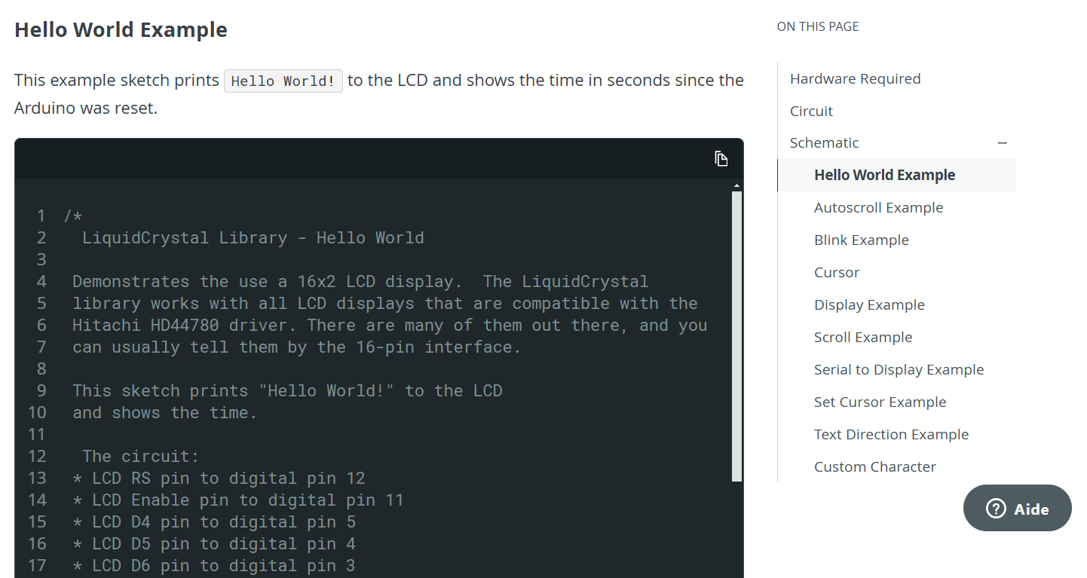
LCD Display Code
The code is also on the website!
press button to copy :)
Notes:
https://docs.google.com/document/d/1EP4RYdVOjiIlbZn7Pg-mr4yuSbNVbKCoE-h3yY7Qrrw/edit?usp=sharing

Slide 10
https://docs.arduino.cc/learn/electronics/lcd-displays/
Type this link into a web browser on the mac computers

